Slide 1
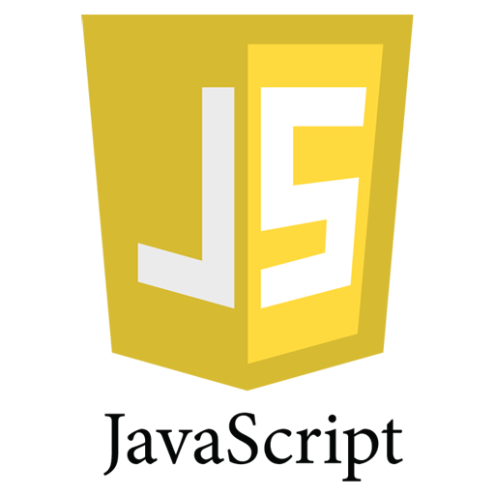
JavaScript Fundamental Basics
- Vasu Nagpal

Slide 2
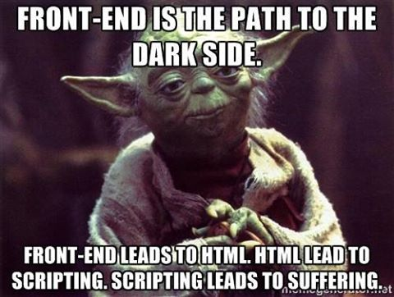
Notes:
This what I initially thought about front end development coming from a .Net background and working in a strongly typed language like c# JavaScript was a nightmare for me, because every time I had to work in JavaSript some or the other thing used to surprise me. Like ”1”+ 2 + 3 = “33” but 1+ 2+ “3” =33 and function a(){alert()} a.age =23; both works , I mean functions are functions and they have to behave like functions aren’t they. Js is such a non standardized language . var a =12; a =“vasu” even this Is valid.

Slide 3

Aila!! This is Magic :/
Notes:
And this is how I was after that .Well eventually what I realized was that it was not JavaScript’s fault it was actually my fault because I directly jumped into the language without understanding the basics and semantics of js . So understanding the basics or semantics of the language is must or even you will end up looking like him.
J

Slide 4

JavaScript Fundamentals: Introduction
Created in 1995 at Netscape
ECMA the un trademarked name
Also used in environments that aren't web-based
The Master Mind
Notes:
Brendan Eich was the master mind behind js and you would be surprised to know that he actually created this language in 10 days.
Js was created by him in 1995 at Netscape, currently Brendan is working at Mozilla and he is also the co founder of Mozilla.
Well after creating Js it was handed to the Echma organization for standardization and I always that that js has no standards.,
after that it was named as ECHMA script so basically the original name of js was ECHMA but it is well known as JavaScript and
the reason being first the author thought the name ECHA sounds like a skin disease and
second when he created the language he was actually briefed to create a language similar to JAVA but would run on the client .
Js is not only for web based it is also used in pdf and vm’s as well JavaScript is not only for web

Slide 5
The Misconceptions
JavaScript has something to do with JAVA.
JavaScript is mostly used for validations on forms.
No need for JavaScript if you know Jquery.
JavaScript runs on Client side only.
JavaScript is not an Object Oriented Language
Notes:
Trust me I have heard people saying this yaar java to ati hai js bhi ho hee jayegi
Specially the testers ohh you are using only js in your project but js is only for form validations
Are JavaScript mein kuch nhi rakh learn JQuery everything is JQuery today, even in my firs company my mentor told me the same thing (img pto)

Slide 6
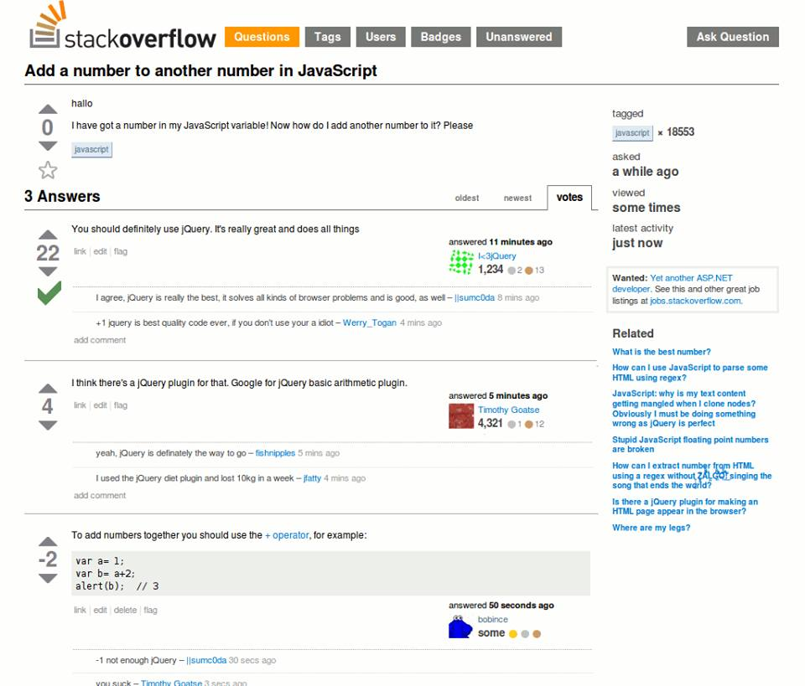
Use right tools at right place
Notes:
Object based

Slide 7
Objects
A collection of properties and methods as key value pairs.
Objects are dynamic they can be extended.(where does the prop come from)
Objects are stored by reference.
Almost every thing in JavaScript is an object.
If you understand objects you understand JavaScript.
Notes:
The book definition says anything that has attributes and behavior of its on own , what I understand is an object is a kind of container and you can add properties and methods on them .
Refer sample

Slide 8
Objects
Object creation pattern
By Object Literal
By using Object() constructor
By using Object.create()
Accessing Object properties
By using dot notation
By using [ ]
Notes:
Refer examples

Slide 9
Constructors
Constructors create and return object instances
class MyClass
{
public int x, y;
// a typical c# constructor
public MyClass()
{
x = 0; y = 0;
}
}
MyClass obj= new MyClass(); //creating instance of MyClass
Notes:
In all classical languages constructor has one common use it is to create objects instances and return them, this is an example of a typical constructor in c#.
But wait a minute do we have classes in js ??then how does this constructor come into the picture.
Let’s see
Object returned from constructor is instance

Slide 10
Constructor Function
Constructor is nothing more than a function invoked with new keyword .
Role of new keyword in Constructor Function
Sets value of this of the parent function to new object being constructed
Returns the newly created object
Every object has a constructor property that points to its parent.
Notes:
Js do not have constructors but they do have constructor functions , these constructors are nothing but a normal function but when they are invoked with a new keyword they become special ,
So basically the new keyword makes them special.
Read role of new ----please refer samples---------
Keyword this is nothing but it points to the current context
we use this similar to the way we use pronouns in natural languages like English and French. We write, “John is running fast because he is trying to catch the train.” Note the use of the pronoun “he.” We could have written this: “John is running fast because John is trying to catch the train.
SHOW EXAMPLE user udefined constructors
Constructor property on an instance gives you the name of its parent
///can refer this example in code
[when we use this in a global function, it refers to (and has the value of) the global window object
Fix this when used in a method passed as a callback $ ("button").click (user.clickHandler); $("button").click (user.clickHandler.bind (user)); // P. Mickelson 43
this inside the anonymous function cannot access the outer function’s this, so it is bound to the global window object, when strict mode is not being used.
http://javascriptissexy.com/understand-javascripts-this-with-clarity-and-master-it]

Slide 11
Native Constructor Function(Data Types)
Number()
String()
Boolean()
Object()
Array()
Function()
Date()
RegExp()
Error()
Native Constructors are used to implement data types in JavaScript
I like to call them as God Objects
Notes:
Js also provides some built in constructor functions which I like to call as god objects which make are used to construct most of the JavaScript. They actually help js to implement datatypes .
Show example

Slide 12

Primitive vs Complex
Number() , String() and Boolean() are special can act as primitive and complex both
Number() , String() and Boolean() when invoked without new keyword creates complex types
Primitive type cannot have dynamic properties while Complex type can
Primitive type are equal by value while Complex type by reference
Primitive types are stored by value while Complex type by reference
Notes:
Js data types can be broadly classified into two categories primitive and complex types .Then show on console create no. by all three methods ; see constructors; print them ; see there types using typeof operator
Complex type have Dynamic typing because of object constructor and no dynamic typing on primitive types

Slide 13
Inheritance in JavaScript
Every JavaScript function has a prototype property which is an empty object of its own type.
An object’s prototype attribute(__proto__) points to the object’s “parent”—the object it inherited its properties from when created using a constructor. Note : use it only on instances.
Inheritance in JavaScript is made possible through the prototype chain properties added after creating instance to do not reflects.
Notes:
Visit the link mentioned in GIT example in prototype folder to understand inheritance properly.
Also visit this link ////////////Inhertitance explained https://skimmable-videos.herokuapp.com/show/558f4dc9c240320300d8ef34 /////////
-attach properties and methods on this prototype property when you want to implement inheritance.
- Safari and Chrome have a __proto__ “pseudo” property (an alternative syntax) that allows you to access an object’s prototype property. You will likely never use this __proto__ pseudo property, but you should know that it exists and it is simply a way to access an object’s prototype property in some browsers.
- If an object is created with an object literal (var newObj = {}), it inherits properties from Object.prototype and we say its prototype object (or prototype attribute) is Object.prototype.
- If an object is created from a constructor function such as new Object (), new Fruit () or new Array () or new Anything (), it inherits from that constructor (Object (), Fruit (), Array (), or Anything ()).
-- if you want to access a property of an object, the search for the property begins directly on the object. If the JS runtime can’t find the property there, it then looks for the property on the object’s prototype—the object it inherited its properties from. If the property is not found on the object’s prototype, the search for the property then moves to prototype of the object’s prototype (the father of the object’s father—the grandfather). And this continues until there is no more prototype (no more great-grand father; no more lineage to follow). This in essence is the prototype chain:

Slide 14
Type Checking And Type Casting
Type Checking
The typeof operator is used to check the type.
Type Casting
By passing the value to the native Constructor
Use of ‘+’ operator to cast Number to String
Notes:
Show example object JavaScript is not a strongly typed language but it still has some types as we already discussed and it gets very difficult at times to identify the type of data you are dealing with.The operator typeof comes to the rescue here.

Slide 15
Truthy Falsy values
If a value is one of these values it is false else it is true
0
null
false
NaN
undefined
””
Notes:
Best way is to check through console using if

Slide 16
Equality Checking
Always use === instead of == for equality checking
== only checks for the value ignores type
=== checks for value as well as type
Exception NaN is not equivalent to anything instead use isNaN()
Notes:
Best way is to check through console using if(val){}

Slide 17

Default And Guard Operators
The Guard operator ‘&&’ does not let false values to pass
The Default operator ‘||’ only let false values to pass also called as short circuiting
Used case(?)
Syntactic sugar helps you to write more in less(example)
Notes:
Show guard and default in console using falsy values
var a = "" || "vasu";
//I have showed a used case in examples

Slide 18
Functions in JavaScript
Functions are first class citizens in JavaScript
can be stored in a variable, array, or object
can be passed to and returned from a function
Variadic Functions (arguments)
When a function is defined in the global scope, the value of this is the global object
Notes:
Functions are very powerful in java script they are first class citizens and highly privileged.

Slide 19
Functions in JavaScript
Type of functions
Constructor Functions
Anonymous Functions
Function Expressions
IIFE(Immediately Invoked Function Expressions ) we can pass params to it as well
Nested Functions

Slide 20
Scoping in JavaScript
Scope is the context in which a property can be found
Types of Scope
Local Scope
Global Scope
Lexical scope is nothing but looking up the scope chain
Without using var in function the variable goes in global scope
Rule of thumb
JavaScript does not respects block scope it only respects function scope
Notes:
Refer example

Slide 21
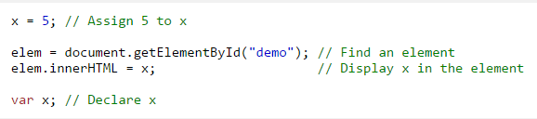
Hoisting in JavaScript
Default behavior of moving declarations to the top.
Only declarations are hoisted not the initialization.
Notes:
Refer example

Slide 22
Closures
A closure is a function having access to the parent scope, even after the parent function has executed.
Can be used to mock classes in JavaScript.
Be careful while using closures for memory leaks.
Notes:
Refer example. Can cause memory leaks if inner function that hold reference to outer scope do not release that variable , Closures are very power full but you need to use them efficiently because pto

Slide 23

Always remember what Uncle Ben said

Slide 24
Resources
Beginner
Code school
JavaScript is sexy
Intermediate
JavaScript Succinctly
MDN
Expert
JavaScript the Good Parts -by David Crockford

Slide 25
Thank You

